Slide 1
Advanced Database
COMP3002 - Week 2 – part 2
Select Command

Slide 2
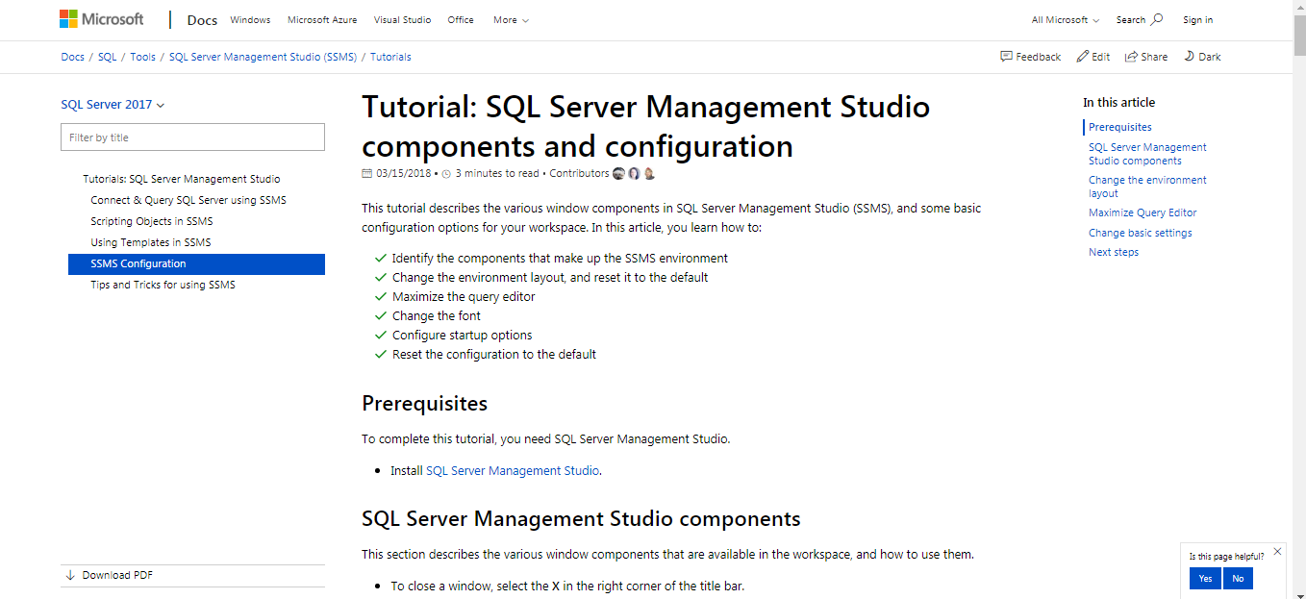
Tutorial: SQL Server Management Studio components and configuration
Click to Visit the official page

Slide 3
SQL comments
Comments are used to explain sections of SQL statements, or to prevent execution of SQL statements.
Single Line Comments
Any text between -- and the end of the line will be ignored (will not be executed).
-- This is a comment
Multi-line Comments
Any text between /* and */ will be ignored.
/*Select all the columns of all the records in the Customers table:*/

Slide 4
Commenting .sql Files
Identify each answer with a comment and PRINT statements, like this:
-- 1.
PRINT ' *** QUESTION 1 *** '
PRINT ' '
(one blank line)
SELECT…

Slide 5
Using the SIS Database
Add this line below your header comment:
USE SIS

Slide 6
SELECT Basics
Select all columns from a table:
SELECT *
FROM table
Example:
-- 1.
SELECT *
FROM Campus

Slide 7
SELECT Basics
Select one column from a table:
SELECT column
FROM table
Example:
-- 2.
SELECT name
FROM Campus

Slide 8
SELECT Basics
Select more than one column from a table:
SELECT column1, column2 [, ...]
FROM table
Example:
-- 3.
SELECT code, name, frenchName
FROM Campus

Slide 9
Column Aliases
Alias a column:
SELECT column1 AS alias, column2 [, ...]
FROM table
Example:
-- 4.
SELECT lastName AS surname, provinceCode
FROM Person

Slide 10
Column Aliases
AS is optional and can be omitted
SELECT column1 alias, column2 [, ...]
FROM table
Example
-- 5.
SELECT lastName surname, provinceCode
FROM person

Slide 11
Expressions
Create a calculated column with an expression:
SELECT column1, expression [, ...]
FROM table
Example
-- 6.
SELECT amount, amount * 10
FROM Payment

Slide 12
Expressions
Use AS to give the calculated column a meaningful name
SELECT column1, expression AS alias [, ...]
FROM table
Example
-- 7.
SELECT amount,
amount * 10 As “Increased payment”
FROM Payment

Slide 13
SELECT DISTINCT
Remove rows with redundant values from the result set:
SELECT DISTINCT column1, column2 [, ...]
FROM table
Example
-- 8.
SELECT DISTINCT provinceCode
FROM Person

Slide 14
ORDER BY
Order by one column in ascending order:
SELECT ...
ORDER BY column ASC
Example
-- 9.
SELECT lastName, firstName
FROM person
ORDER BY lastName ASC

Slide 15
ORDER BY
ASC is the default and therefore is optional (and seldom used in practice)
SELECT ...
ORDER BY column
Example
-- 10.
SELECT lastName, firstName
FROM person
ORDER BY lastName

Slide 16
ORDER BY
Order by one column in descending order:
SELECT ...
ORDER BY column DESC
Example:
-- 11.
SELECT lastName, firstName
FROM person
ORDER BY lastName DESC

Slide 17
ORDER BY
Order by column2 within column1:
SELECT ...
ORDER BY column1, column2
Example:
-- 12.
SELECT lastName, firstName
FROM person
ORDER BY lastName, firstName
Notes:
http://www.dofactory.com/sql/order-by

Slide 18
ORDER BY
Order by column2 within column1 descending
SELECT ...
ORDER BY column1 DESC, column2
Example:
-- 13.
SELECT lastName AS surname, firstName
FROM person
ORDER BY lastName DESC, firstName
Notes:
http://www.dofactory.com/sql/order-by

Slide 19
ORDER BY
Order by column2 within column1 descending using an aliased column
SELECT ...
ORDER BY column1 DESC, column2
Example:
-- 13.
SELECT lastName AS surname, firstName
FROM person
ORDER BY surname DESC, firstName
19

Slide 20

Review the video

Slide 21
WHERE Clause
Syntax:
SELECT …
WHERE condition
condition is in the form:
column relationalOperator value
Notes:
http://www.dofactory.com/sql/where

Slide 22
Relational Operators
<
>
<=
>=
=
!=
less than
greater than
less than or equal to
greater than or equal to
equal to
not equal to
Notes:
Don't have to worry about == or ===

Slide 23
WHERE Clause
Select with where using equal to (=)
Example:
-- 15.
SELECT lastName, firstName
FROM Person
WHERE provinceCode = 'ON'

Slide 24
Single and Double Quotes
Use single quotes around literal values in a SQL statement
…WHERE provinceCode = 'ON'
Many database products let you omit single quotes for numeric literals
Double quotes are used for nonstandard column names
…WHERE value = “name with embedded spaces”
…WHERE value = “name with illegal character like @”

Slide 25
WHERE Clause
SELECT with WHERE using not equal (!=)
Example:
-- 16.
SELECT lastName, firstName
FROM Person
WHERE provinceCode != 'ON'

Slide 26
WHERE Clause
SELECT with WHERE using greater than (>)
Example:
-- 17.
SELECT balance
FROM Student
WHERE balance > 100.00
ORDER BY balance
Notes:
So if tom has a balance of 149 and john has a balance of 133, then john will be listed before tom

Slide 27
Compound Expressions
… WHERE NOT condition
Means “do not include rows that meet the condition in the result set”
… WHERE condition1 AND condition2
Means “include only rows that meet both condition1 and condition2 in the result set”
… WHERE condition1 OR condition2
Means “include rows that meet condition1, condition2, or both in the result set”

Slide 28
Compound Expressions: NOT
WHERE clause conditions can be negated with NOT
SELECT ...
WHERE NOT condition
Example:
SELECT *
FROM Student
WHERE NOT academicStatus = 'N'
Notes:
Could be written as WHERE academicStatus != 'N'

Slide 29
Compound Expressions: AND
WHERE clause conditions can be combined with AND
SELECT ...
WHERE condition1
AND condition2
Example:
SELECT *
FROM Student
WHERE academicStatus = 'N'
AND financialStatus = 'N'

Slide 30
Compound Expressions: OR
WHERE clause conditions can be combined with OR
SELECT ...
WHERE condition1
OR condition2
Example:
SELECT *
FROM Student
WHERE academicStatus = 'N'
OR financialStatus = 'N'

Slide 31
Precedence
Precedence refers to the order of evaluation:
NOT
AND
OR
NOT is highest because it is unary
AND takes precedence over OR by convention

Slide 32
Precedence
Operator precedence in computing is like “order of operations” in arithmetic
The “golden rule”:
When in doubt, use parentheses

Slide 33
Printing
To print your SQL code:
Click in the window where the SQL code is displayed
Select File > Print from the SQL Server Management Studio Express menu

Slide 34
Printing
To print your output:
1- Select Query > Results in Text from the SQL Server Management Studio Express menu
2- Run the query with F5 or Query > Execute
Click in the window where the output is displayed
Select File > Print from the SQL Server Management Studio Express menu

Slide 35
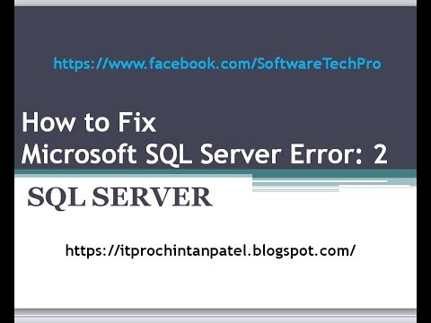
Appendix I - How to Solve SQL Server Error : 2

